Slide 1

Analysis of Parts of Speech (POS) Using Statistical and Deep Learning Methods
05.11.25
By: Nishvi Pradipkumar Patel, Charmilkumar Vijaykumar Patel, Yash J Patel

Slide 2
Introduction
POS tagging assigns grammatical roles (noun, verb, adjective, etc.) to words in a sentence.
It’s essential for tasks like translation, sentence parsing, and information extraction.
Challenge: Some words change meaning depending on context (e.g., “dogs” as noun vs. verb).
Our goal: Compare Logistic Regression (statistical) and LSTM (deep learning) to see which works better for POS tagging using limited features.

Slide 3
2. Related Work
Pranckevicius & Marcinkevicius (2016): Logistic Regression works well with good features but struggles with complex patterns.
Patoary et al. (2020): LSTM handles complex language better but needs more data and computing power.
Chiche & Yitagesu (2022): Deep learning generally outperforms machine learning, especially when context matters.

Slide 4
3. Dataset Description
Kaggle dataset with 370,100 rows and 2 columns (words, POS tags).
POS tags include: nouns (NN), verbs (VB), adjectives (JJ), adverbs (RB), conjunctions (CC), prepositions (IN), etc.
A balanced label distribution typically ensures fair model comparison. However, in this study, the models are trained on a randomly sampled word level dataset with an imbalanced label distribution, in order to investigate whether different modeling approaches can still accurately predict POS tags under such conditions.
Features used: word length, syllable count, punctuation, prefixes/suffixes, and frequency.

Slide 5
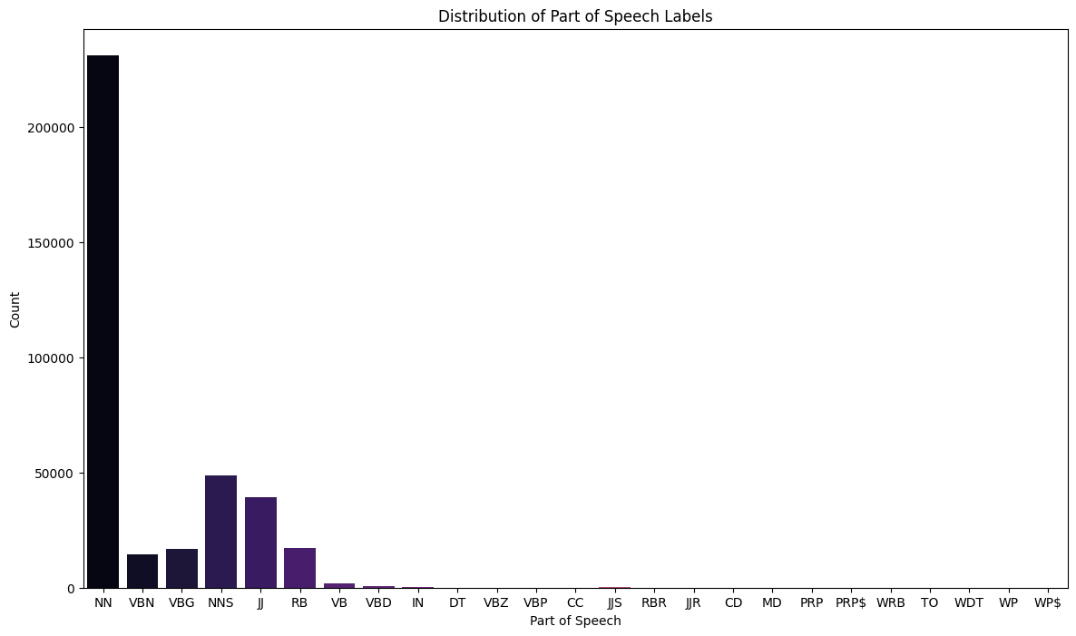
4. Feature Visualizations

Slide 6
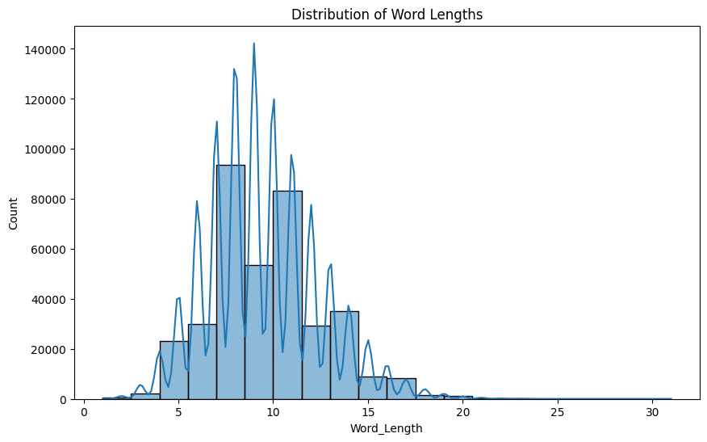
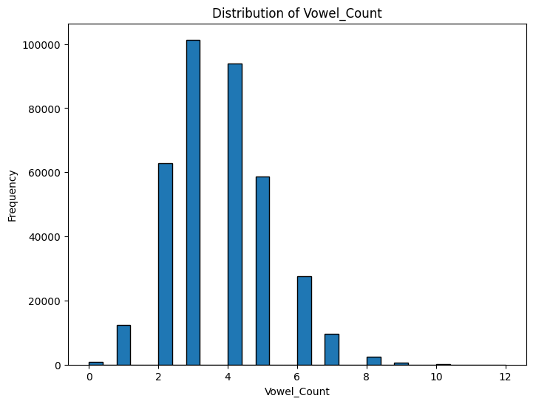
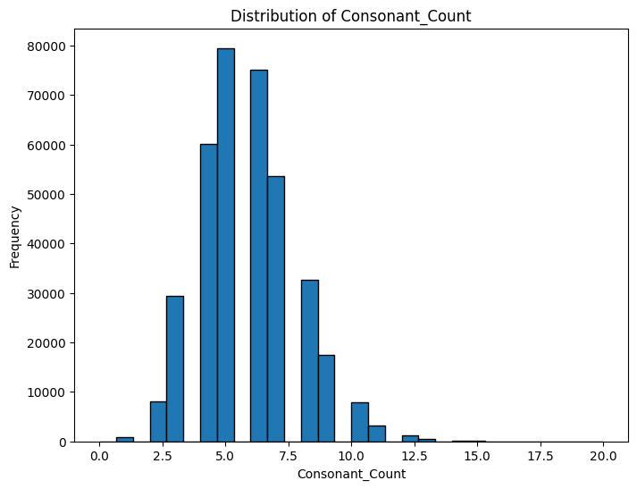
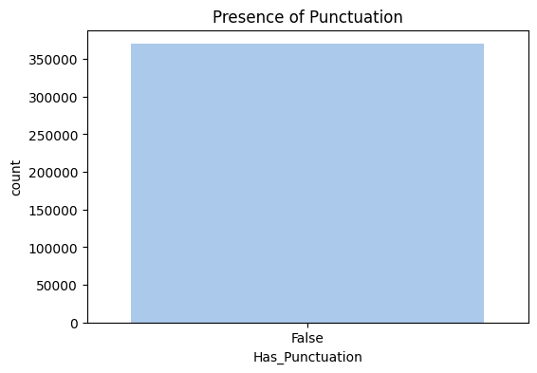
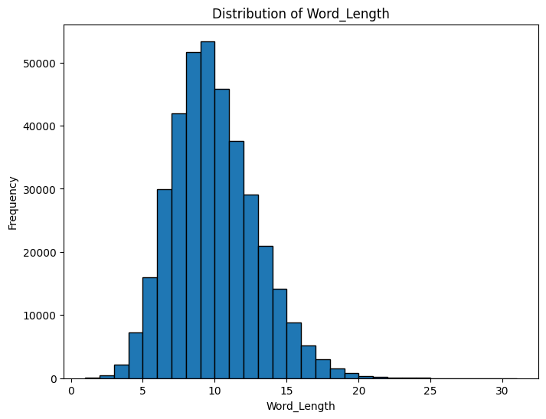
4. Feature Visualizations

Slide 7
5. Logistic Regression Approach
Purpose: Baseline statistical model for POS tagging due to its simplicity, interpretability, and efficiency.
Dataset: 370k-word corpus with POS tags and custom-engineered features.
🛠️ Implementation Steps
Dataset Loading: Imported CSV with English words and their respective POS tags.
Feature Engineering:
Word length
Vowel & consonant counts
Syllable count
Word frequency
Prefix/suffix presence
Punctuation flag
Outlier Handling: Used Z-score method to detect and replace extreme values with mean.
Label Encoding: POS tags were encoded numerically using LabelEncoder.
Model Training: Trained Logistic Regression using Scikit-learn (multinomial, lbfgs, max_iter = 500).
Evaluation: Accuracy, precision, recall, and F1-score reported through classification report.

Slide 8
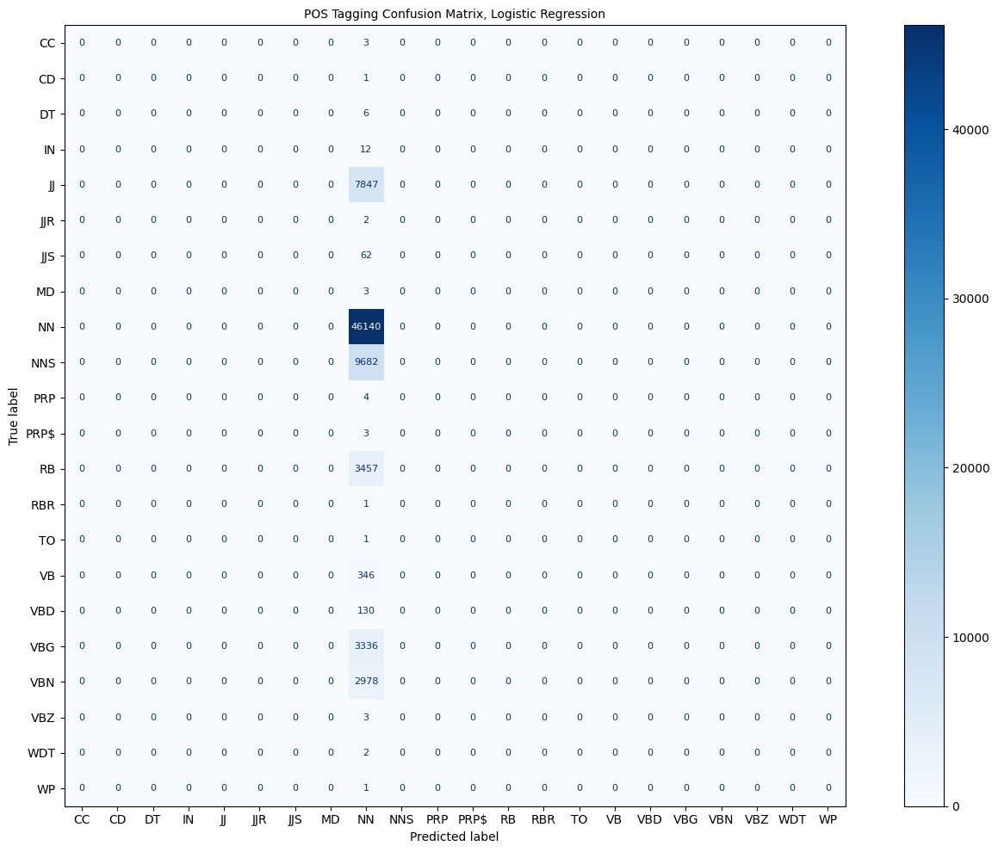
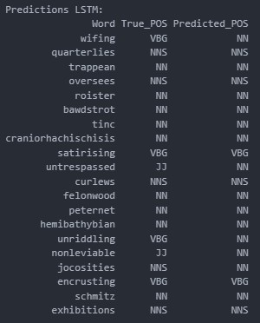
Logistic Regression
Results
Accuracy: 0.6233450418805728
Precision: 0.3885590412370931
Recall: 0.6233450418805728
F1 Score: 0.4787140518037555

Slide 9
6. Logistic Regression + PCA
Purpose: Used PCA to reduce dimensionality and improve model performance for POS tagging at the word level.
Dataset: 370k-word corpus with engineered linguistic features.
🛠️ Implementation Steps
Feature Scaling: Standardized all features using StandardScaler to ensure equal contribution.
Dimensionality Reduction: Applied PCA to reduce features to 2 principal components.
Model Training: Trained Logistic Regression on PCA-transformed data (max_iter = 500).
Prediction & Evaluation: Measured accuracy, precision, recall, F1-score. Compared with original model.
Visualization: 2D scatter plot of PCA projections colored by predicted POS tags to assess class separation.

Slide 10
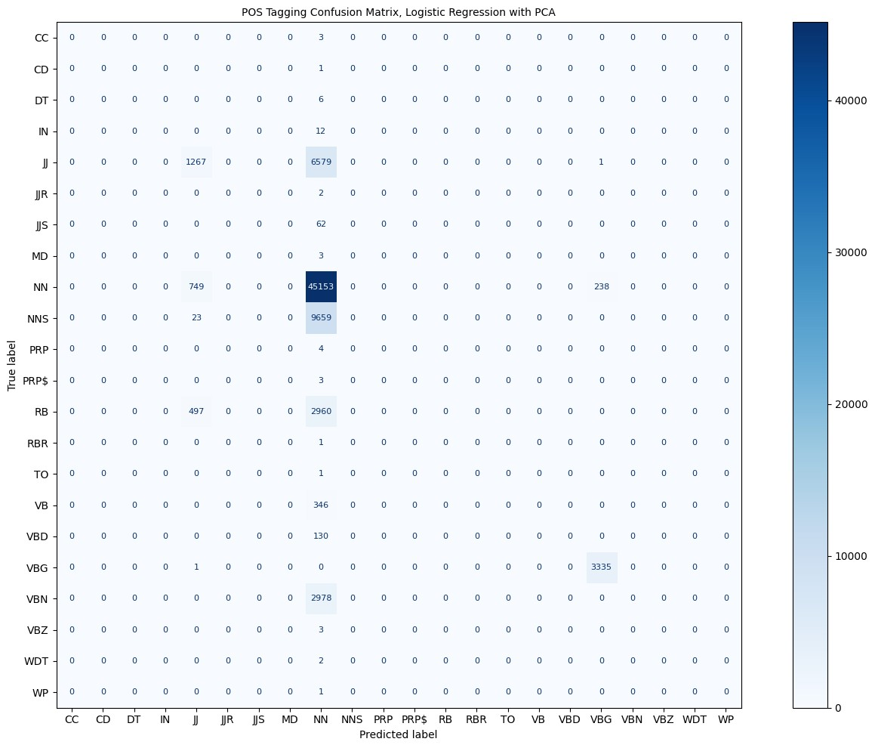
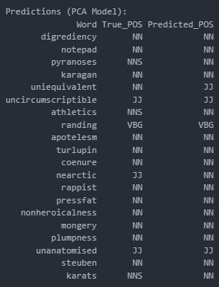
Logistic Regression + PCA Results
Accuracy: 0.672183193731424
Precision: 0.5094632505571729
Recall: 0.672183193731424
F1 Score: 0.5629491045901693

Slide 11
5. Logistic Regression - Word2Vec
Objective: Enhance POS tagging by combining semantic word embeddings with traditional linguistic features.
Embedding Tool: Word2Vec – captures contextual meaning of words from a 370k-word POS-tagged dataset.
🛠️ Implementation Steps
Text Preprocessing: Lowercasing, tokenization, and removal of stopwords and non-alphabetic tokens using NLTK.
Word2Vec Training: Trained on the tokenized dataset to learn word semantics based on context.
Vector Representation: Generated vectors for each word; handled out-of-vocabulary (OOV) words with zero vectors. And Averaged token vectors for final word representation.
Feature Construction: Combined Word2Vec vectors with:
Word length
Vowel count
Consonant count
Model Training: Split data into 80% train, 20% test. And Trained Logistic Regression using multinomial loss and lbfgs solver.
Evaluation: Used accuracy, precision, recall, and F1-score through classification report.

Slide 12
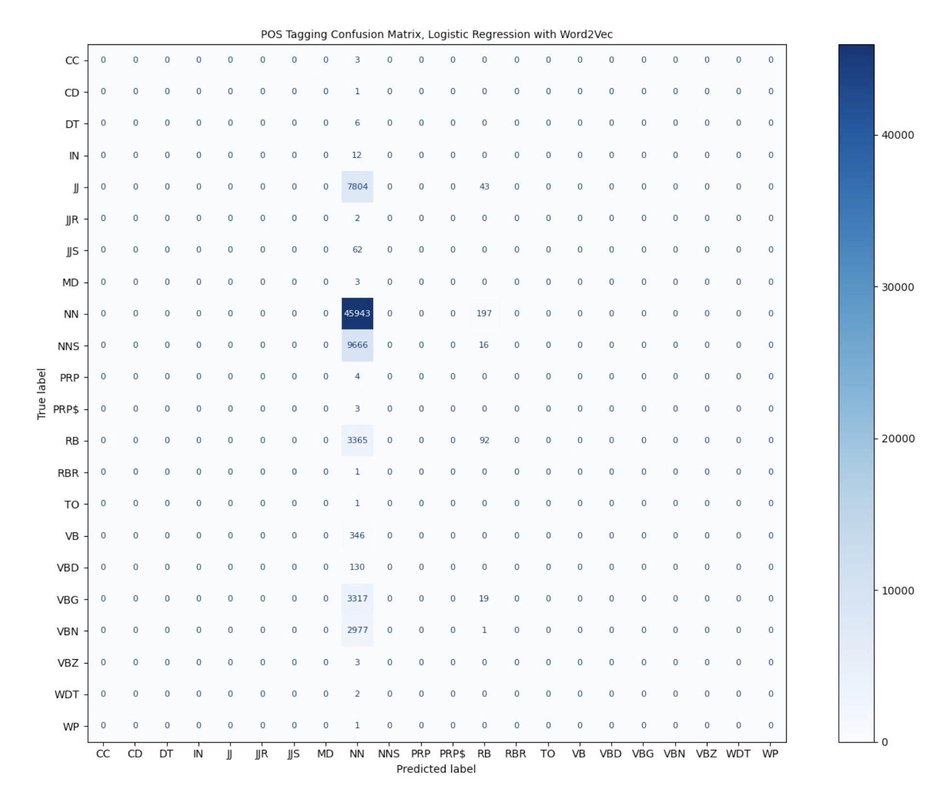
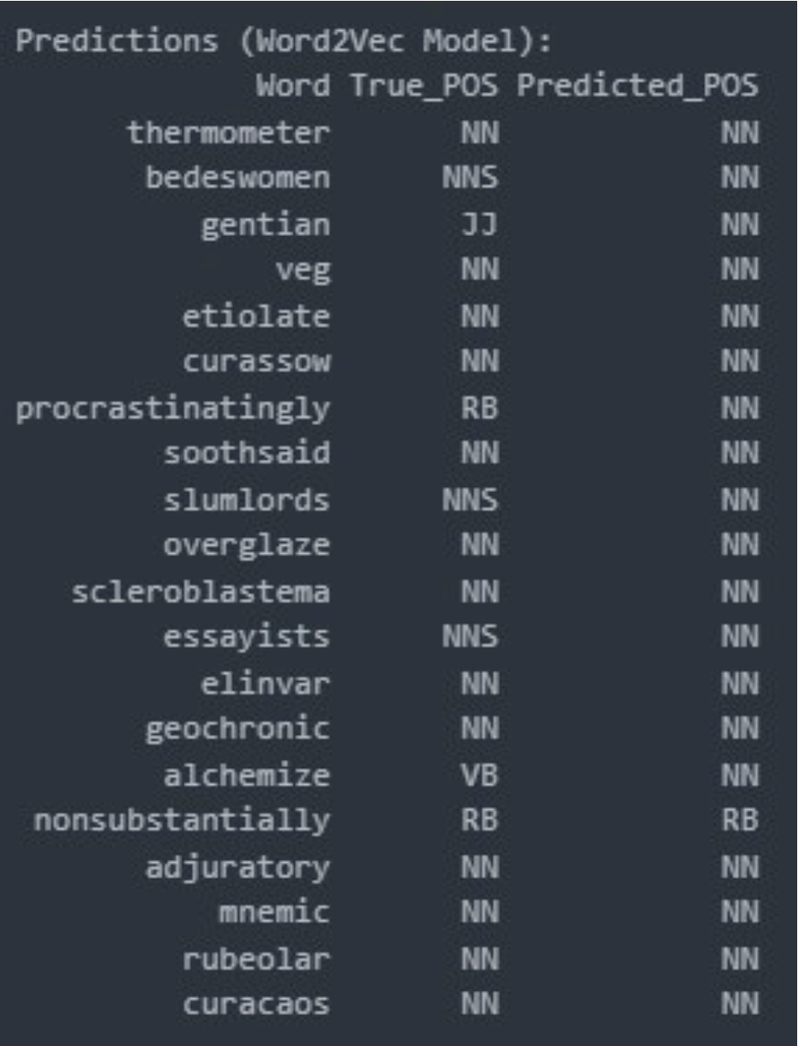
Logistic Regression + Word2Vec Results
Accuracy: 0.6219265063496352
Precision: 0.4005090768547468
Recall : 0.6219265063496352
F1 Score: 0.48038111056884186

Slide 13
5. Bidirectional LSTM - GloVe Embedding
Objective: Leverage LSTM's sequential learning ability with GloVe word embeddings for accurate POS tagging.
Approach: Bidirectional LSTM model using pre-trained 100-dim GloVe vectors and contextual sequence learning.
🛠️ Implementation Steps
Word Tokenization: Tokenized words using Keras Tokenizer with <OOV> handling and padded sequences to length 10.
Embedding Layer: Loaded 100D GloVe vectors via Gensim, created an embedding matrix, and initialized the Embedding layer.
Label Preparation & Data Split: Encoded POS tags using LabelEncoder; split data into 80% training and 20% testing.
Model Architecture: Built model using TensorFlow Sequential API: Embedding → Bi-LSTM (128) → Dropout (50%) → Bi-LSTM (64) → Dense (Softmax).
Training Setup: Compiled with sparse_categorical_crossentropy loss, adam optimizer, and accuracy metric; trained with batch size 64, up to 20 epochs with early stopping.
Evaluation: Predictions made using argmax; evaluated using classification_report.

Slide 14
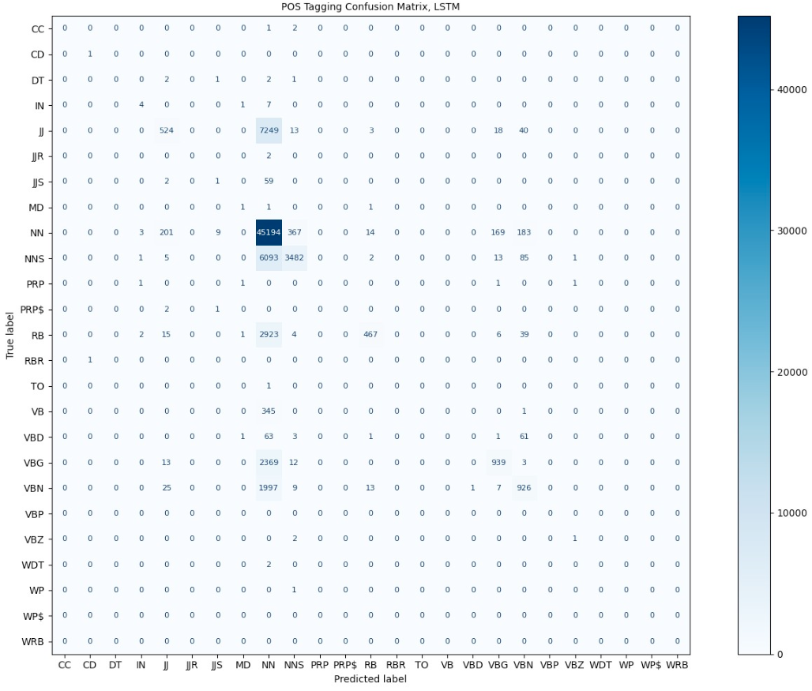
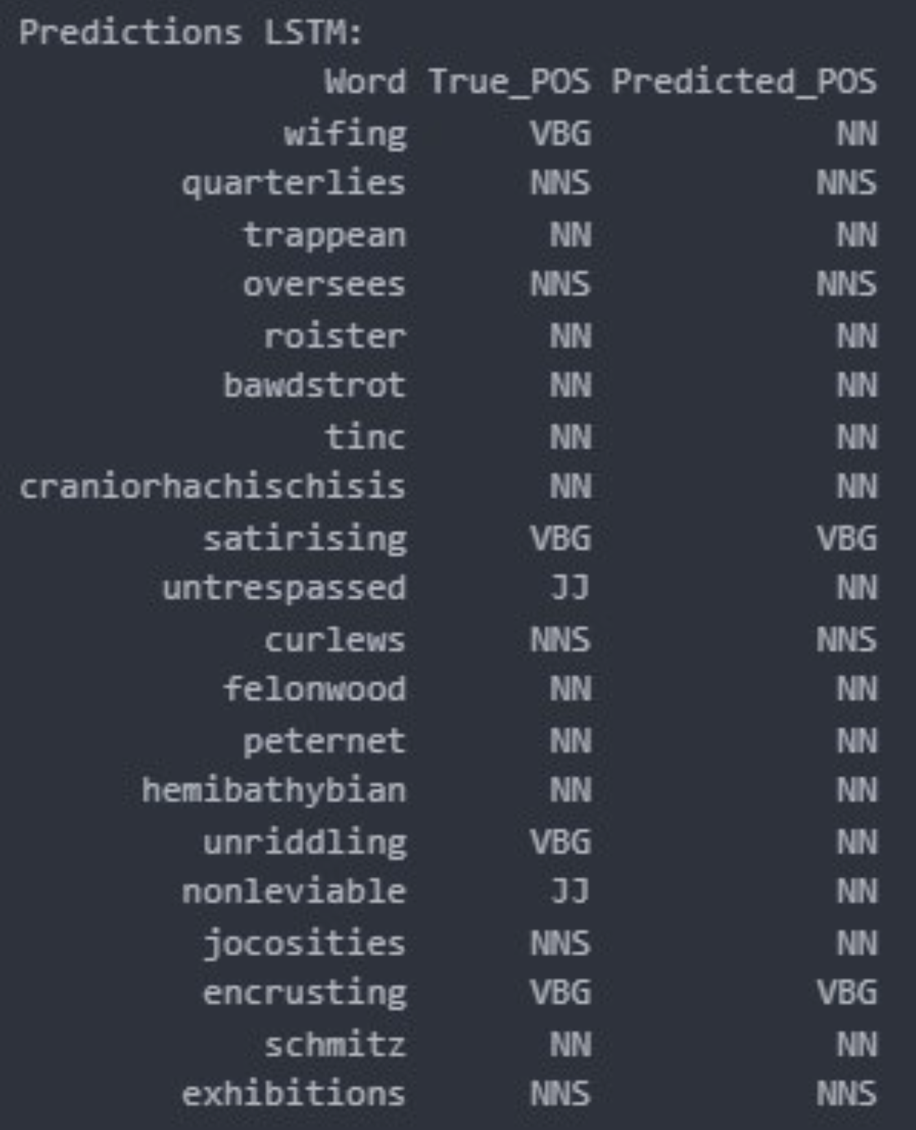
Bidirectional LSTM + GloVe
Accuracy: 0.6955147257497973
Precision: 0.717456052023042
Recall: 0.6955147257497973
F1 Score: 0.6278637544122022

Slide 15
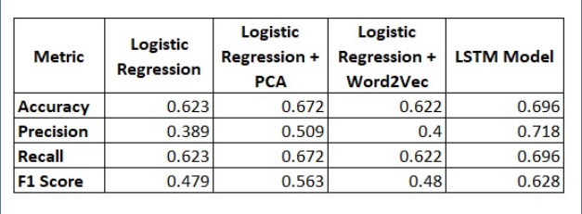
7. Results Comparison
LSTM Model outperforms all other approaches across all metrics.
PCA + Logistic Regression significantly improves precision and F1 Score over the baseline.
Word2Vec with Logistic Regression offers marginal improvement in precision.
Traditional Logistic Regression has the lowest precision and F1 Score, highlighting the advantage of advanced embeddings and sequential learning.

Slide 16
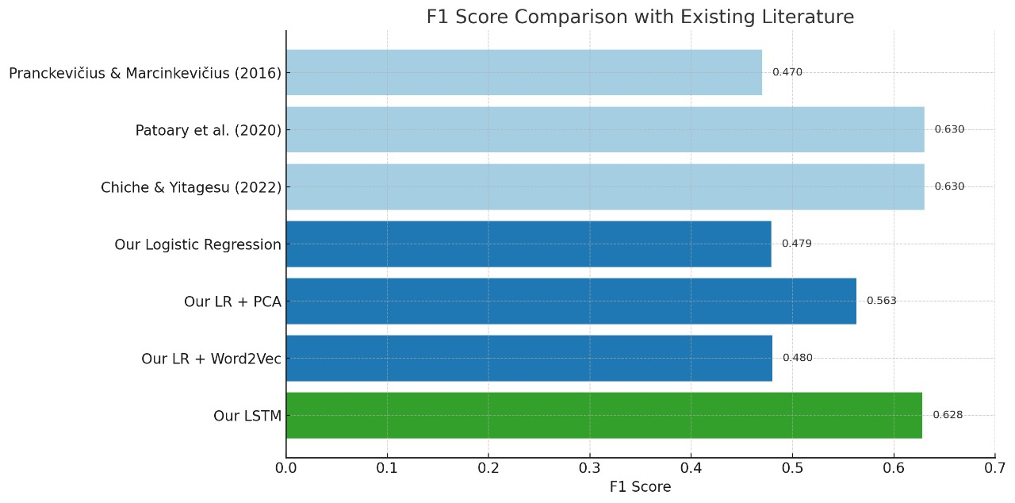
Results Comparison
🔍 F1 Score Comparison with Existing Literature
Our LSTM model (F1: 0.628) closely matches the benchmark of deep learning models (Patoary et al., Chiche & Yitagesu).
Logistic Regression + PCA (F1: 0.563) outperformed baseline Logistic Regression and Word2Vec-enhanced models.
Confirms literature findings:
Deep learning = higher accuracy (LSTM best overall)
Classical models = efficient & practical with proper feature engineering
Highlights LSTM's generalizability and classical models' deployment ease.

Slide 17
8. Future Directions
Advanced Embeddings: Integrate contextual embeddings (BERT, ELMo) for deeper language understanding.
Hybrid Models: Combine statistical (Logistic Regression) and neural (LSTM) models to enhance accuracy and robustness.
Real-Time Use Cases:
Chatbots & Virtual Assistants
Speech-to-Text Systems
Language Learning Platforms
Deployment Readiness:
Optimize for speed and memory usage
Enable use in mobile apps and online tools
Practical and efficient POS tagging for daily applications

Slide 18
9. Conclusions
Evaluated Logistic Regression and LSTM models on 370k-word English POS dataset.
Logistic Regression (with PCA/Word2Vec) provided a simple and interpretable baseline.
LSTM outperformed in capturing complex, sequential patterns.
Unique word-level tagging perspective (vs. traditional sentence-level focus).
Highlights the trade-off between accuracy and interpretability.
Lays foundation for future improvements in POS tagging systems.

Slide 19
Sources
[1]
[2]
[3]
Pranckevičius, T., \& Marcinkevičius, V. (2016). Comparison of classical machine learning algorithms for multi-class classification of sentiment in Twitter. Informatica, 27(1), 85–97. https://doi.org/10.15388/Informatica.2016.107
Patoary, M. M. H., Karim, M. R., Chowdhury, S. A., \& Rahman, M. M. (2020). Part-of-speech tagging of Bengali texts using deep learning models. SN Computer Science, 1(4), 1–9. https://doi.org/10.1007/s42979-020-00247-9
A. Chiche \& B. Yitagesu, “Part of speech tagging: a systematic review of deep learning and machine learning approaches,” Journal of Big Data, vol. 9, no. 10, 2022. doi: 10.1186/s40537-022-00561-y

Slide 20
Zoom Recording :

